Slide 1
Physical mathematics 1.1 Statements
Assumptions of Physics collaboration

Slide 2
Outline
To develop a mathematical framework to keep track of the logical relationships between the statements that originate from the semantics of the statement

Slide 3

Universal $→$ same for everybody
First, let’s address these
Non-contradictory $→$ either something is true or false
Evidence based $→$ truth is determined experimentally
Statements: assertions that are universal and non-contradictory
Notes:
Examples -> Conclusion -> Some assertion are not universal
(Quine’s paradox – Yablo’s paradox) -> Logical consistency is not a property of individual statements -> Introduce the idea of logical contexts.

Slide 4
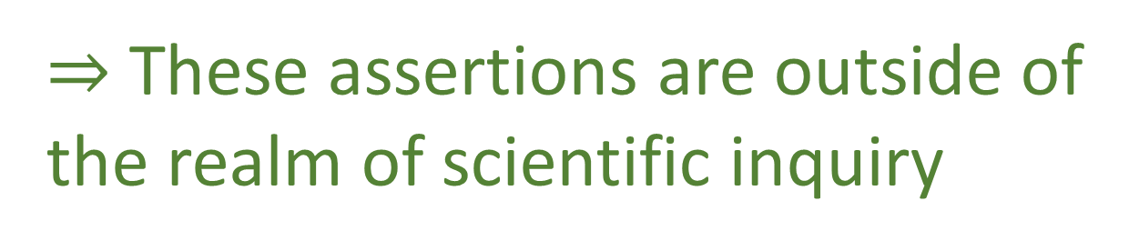
Not all assertions are universal
Jazz is marvelous
Different people may have different opinions
Green and red go well together
Is it morally justified to kill one person to save five
$⇒$ These assertions are outside of the realm of scientific inquiry

Slide 5
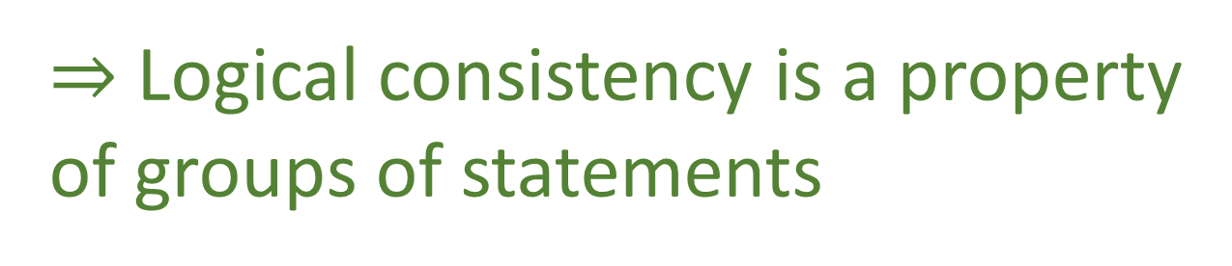
Liar paradox
Quine’s paradox
Yablo’s paradox
$⇒$ Logical consistency is a property
of groups of statements

Slide 6
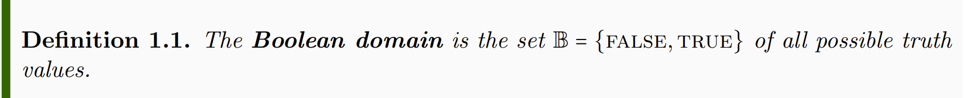
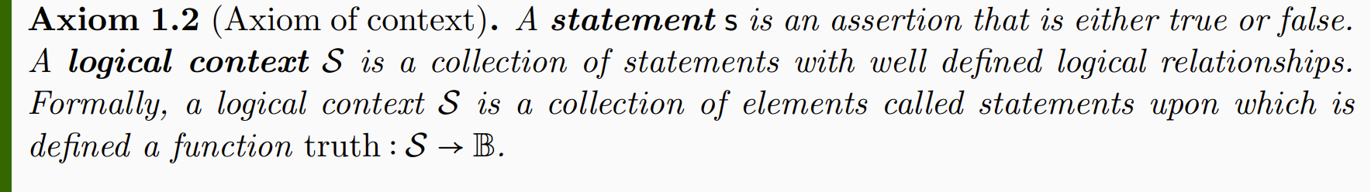
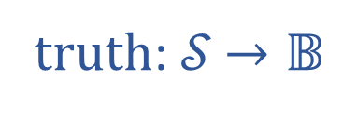

Informal part
Formal part
truth: 𝒮 $→𝔹$
𝒮
$$𝔹$$

Slide 7
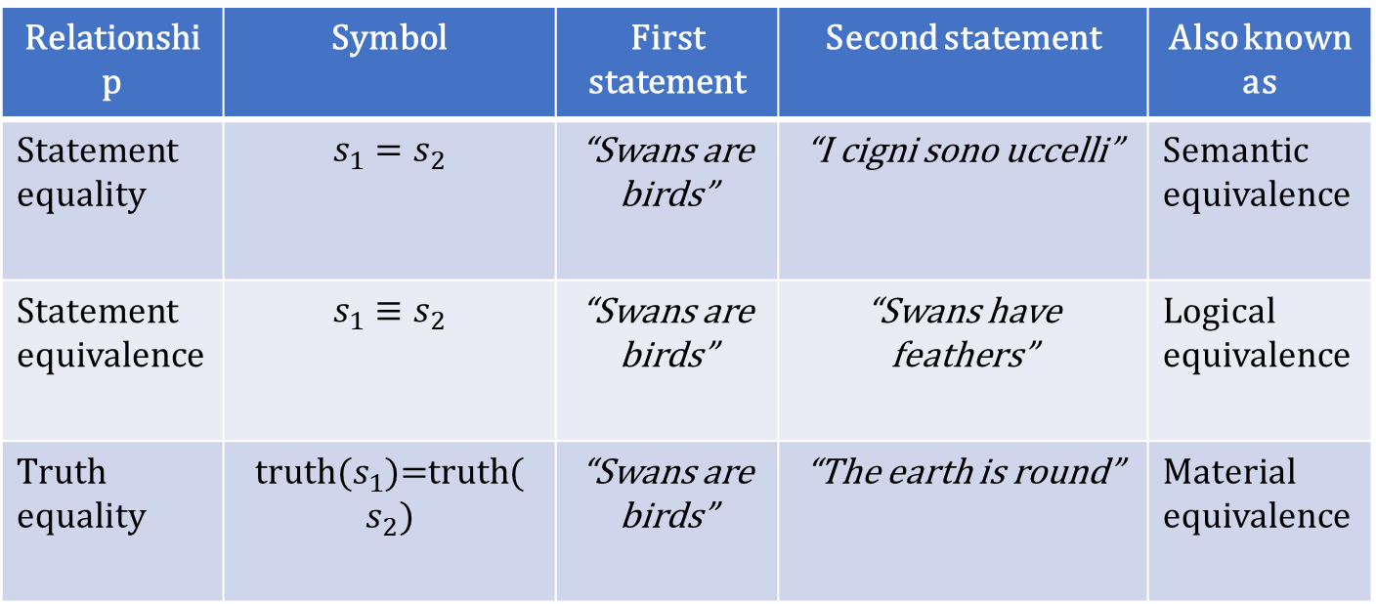
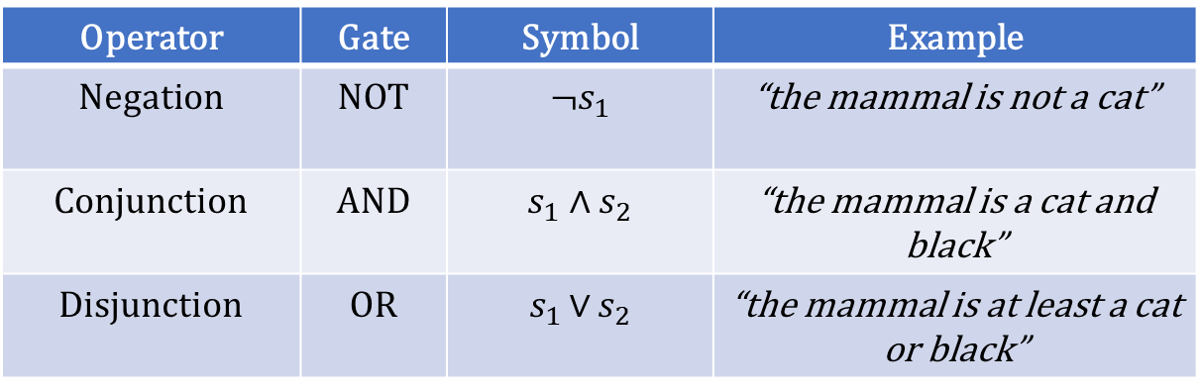
TODO: grammar rules, language, etc…
Operator | Gate | Symbol | Example
Negation | NOT | ¬$s_{1}$ | “the mammal is not a cat”
Conjunction | AND | $$s_{1} \text{∧ }s_{2}$$ | “the mammal is a cat and black”
Disjunction | OR | $s_{1 }\text{∨}$ $s_{2}$ | “the mammal is at least a cat or black”
Relationship | Symbol | First statement | Second statement | Also known as
Statement equality | $$s_{1}=s_{2}$$ | “Swans are birds” | “I cigni sono uccelli” | Semantic equivalence
Statement equivalence | $$s_{1}≡s_{2}$$ | “Swans are birds” | “Swans have feathers” | Logical equivalence
Truth equality | truth($s_{1}$)=truth($s_{2})$ | “Swans are birds” | “The earth is round” | Material equivalence
Notes:
The statements are “prime elements”, no specified further (in terms of grammar, etc…), structure and meaning of the assertion is not part of the formal system (because it would be impossible… web of meaning)

Slide 8
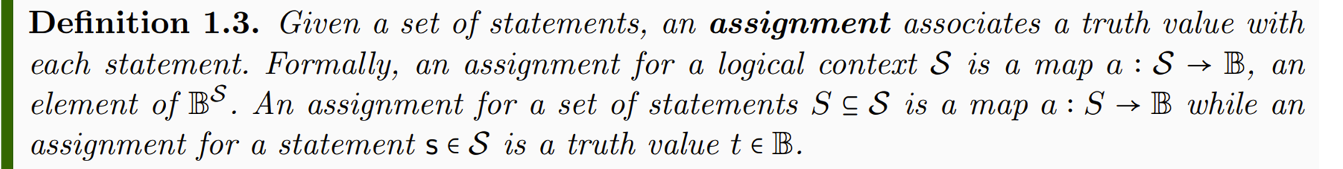
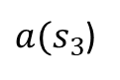
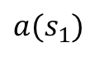
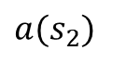
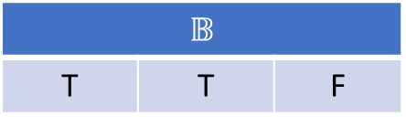
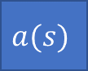
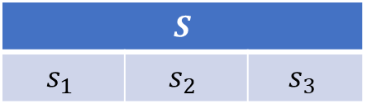
TODO: make horizontal
$$S$$
$$s_{1}$$ | $$s_{2}$$ | $$s_{3}$$
$$a(s)$$
$$𝔹$$
T | T | F
$$a(s_{1})$$
$$a(s_{2})$$
$a(s_{3}$)
Notes:
Part of the semantic content of the statements is captured by what truth value can be assigned

Slide 9
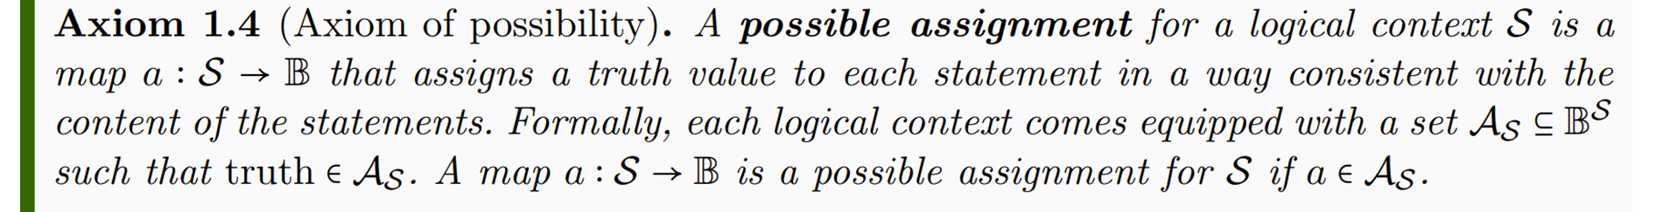
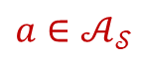
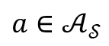
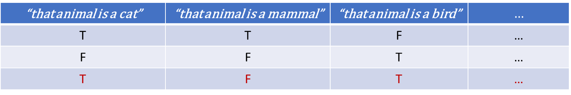
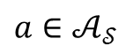
TODO: columns with text, add an “impossible assignment”
“that animal is a cat” | “that animal is a mammal” | “that animal is a bird” | $$…$$
T | T | F | …
F | F | T | …
T | F | T | …
$$a{∈𝒜}_{𝒮}$$
$$a{∈𝒜}_{𝒮}$$
$$a{∈𝒜}_{𝒮}$$
Notes:
Possible assignments are determined by the semantic content of the statements

Slide 10
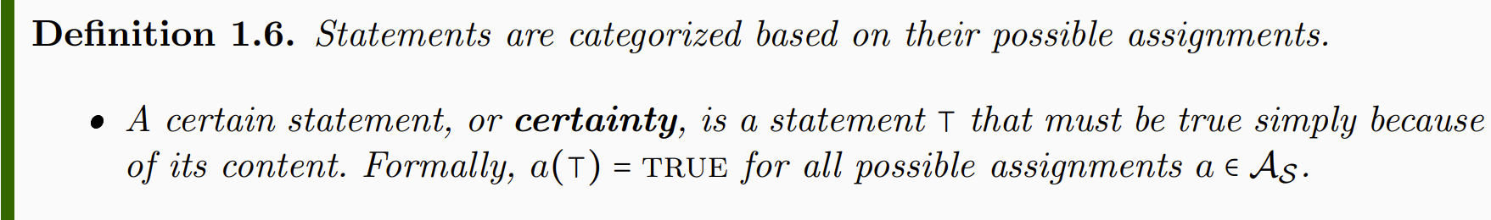
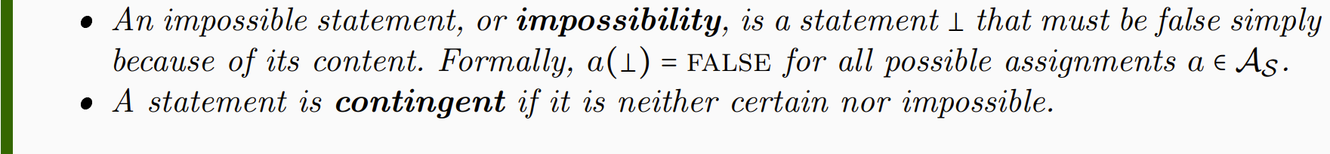
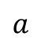
TODO: Table
“that cat is a mammal” | “that mammal is a cat” | “that mammal is a bird”
T | T | F
T | F | F
T | F | F
T | T | F
… | … | …
$$a$$
Notes:
NOTE: whether a statement is a certainty or not depends on context. Mass of the electron: contingent if measuring the mass, certainty for particle identification

Slide 11
Notes:
Want to keep track whether the truth of one statement depends on the truth of others: function on truth values – introduce truth tables

Slide 12
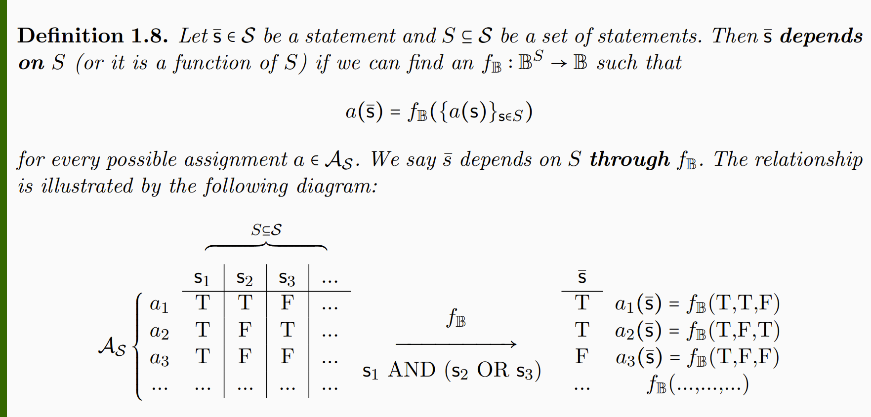

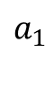
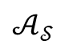
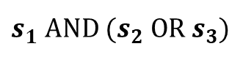
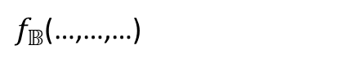
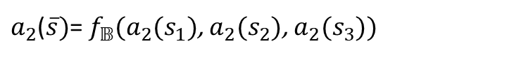
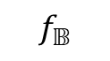

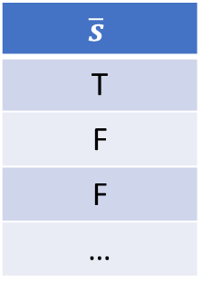
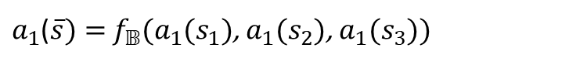
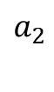
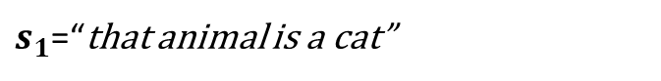
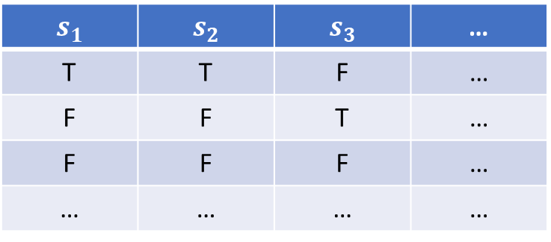
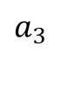
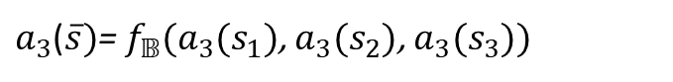
$$S$$
$$s_{1}$$ | $$s_{2}$$ | $$s_{3}$$ | …
T | T | F | …
F | F | T | …
F | F | F | …
… | … | … | …
$$\overline{s}$$
T
F
F
…
$$a_{1}$$
$a_{1}$($\overline{s})=$ $f_{𝔹}(a_{1}(s_{1})$, $a_{1}(s_{2}$), $a_{1}(s_{3}$))
$$a_{2}$$
$$f_{𝔹}$$
$a_{2}$($\overline{s})$= $f_{𝔹}(a_{2}(s_{1})$, $a_{2}(s_{2}$), $a_{2}(s_{3}$))
$$𝒜_{𝒮}$$
$$a_{3}$$
$s_{1}$ AND ${(s}_{2} OR{ s}_{3})$
$a_{3}$($\overline{s})$= $f_{𝔹}(a_{3}(s_{1})$, $a_{3}(s_{2}$), $a_{3}(s_{3}$))
$$…$$
$f_{𝔹}$(…,…,…)
$s_{1}$=“that animal is a cat”
$s_{2}$=“that animal is a mammal”
$s_{3}$=“that animal is a bird”
Notes:
Applying truth tables to the assignments

Slide 13
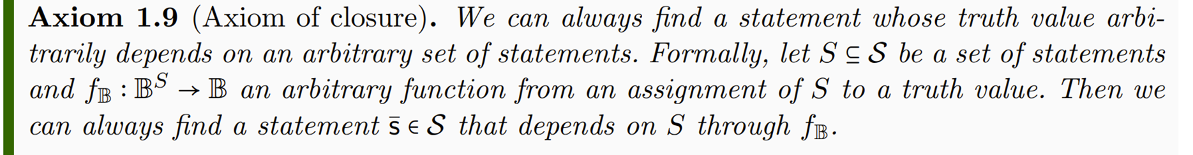


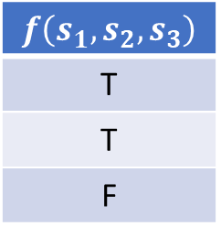
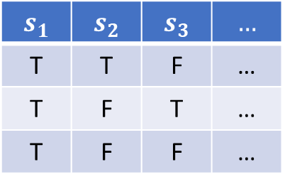
$$s_{1}$$ | $$s_{2}$$ | $$s_{3}$$ | $$…$$
T | T | F | …
T | F | T | …
T | F | F | …
$$f\left(s_{1},s_{2},s_{3}\right)$$
T
T
F
$$f_{𝔹}$$
Notes:
The logical context will allows allow all possible truth functions

Slide 14
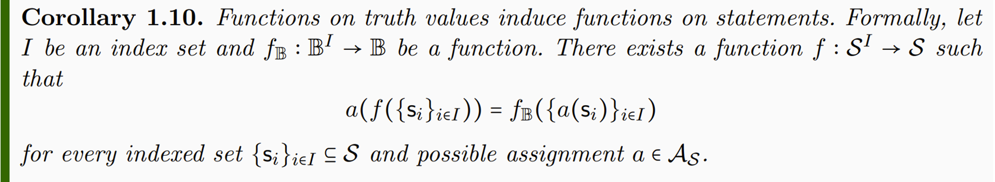

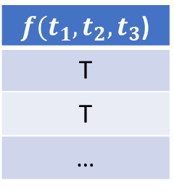
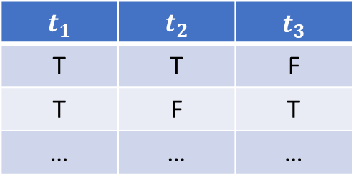
$$t_{1}$$ | $$t_{2}$$ | $$t_{3}$$
T | T | F
T | F | T
… | … | …
$f(t_{1},t_{2},t_{3}$)
T
T
…
Notes:
-> Functions on truth values induce functions on statements

Slide 15
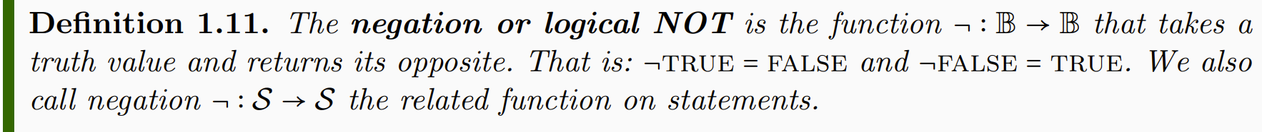
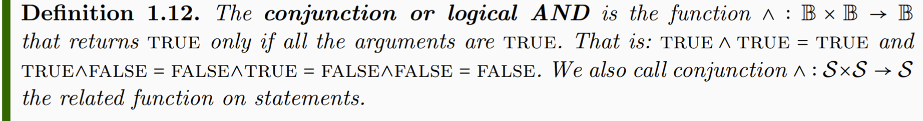
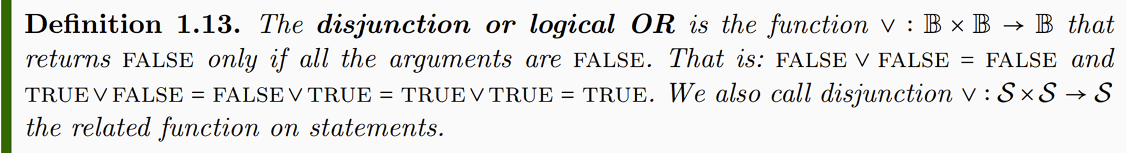

Slide 16
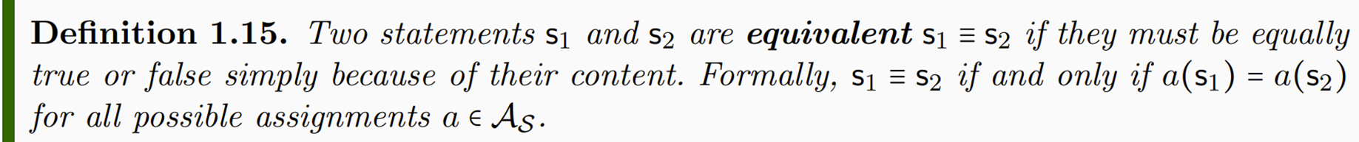
Notes:
Different notion of equivalence Table 1.2

Slide 17
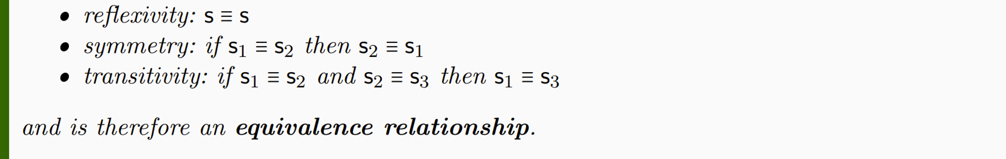
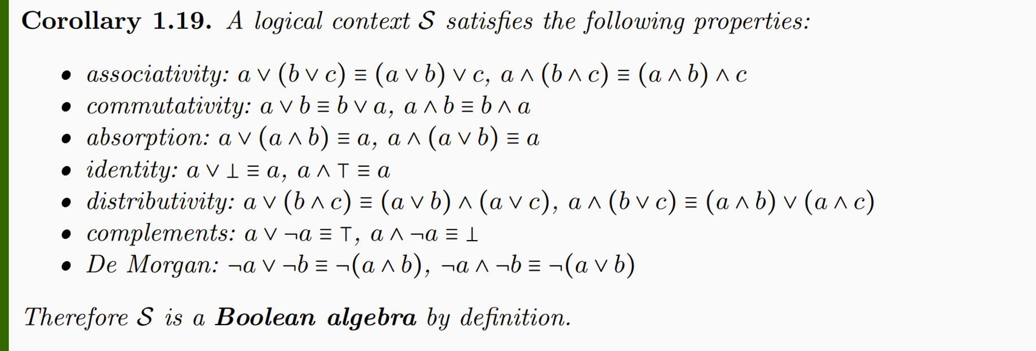

Slide 18
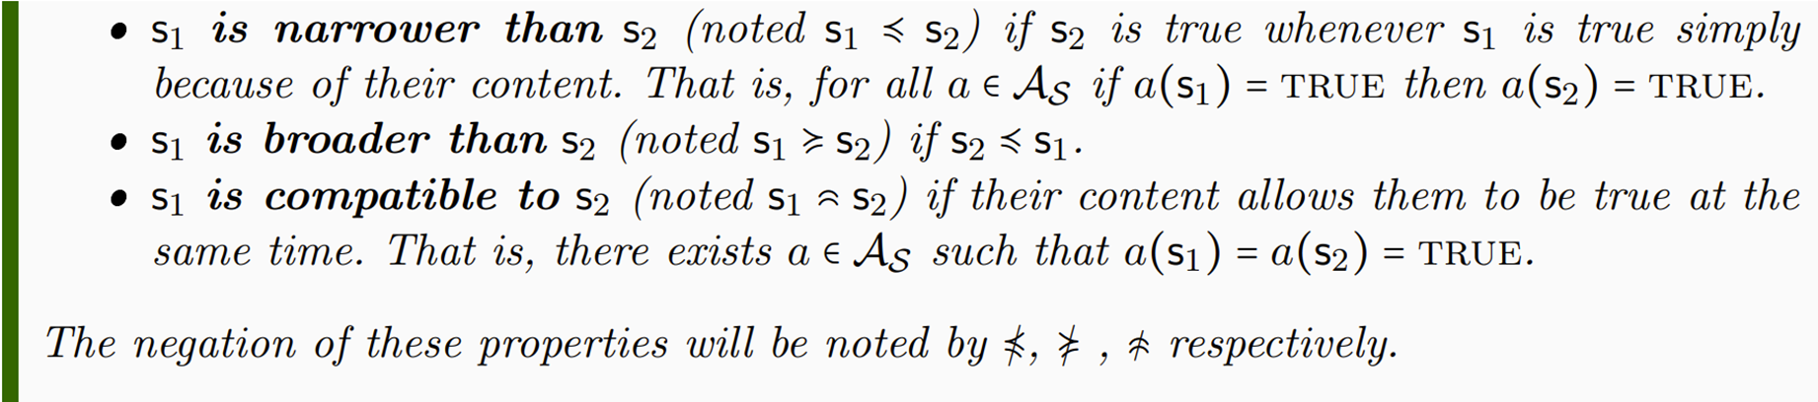
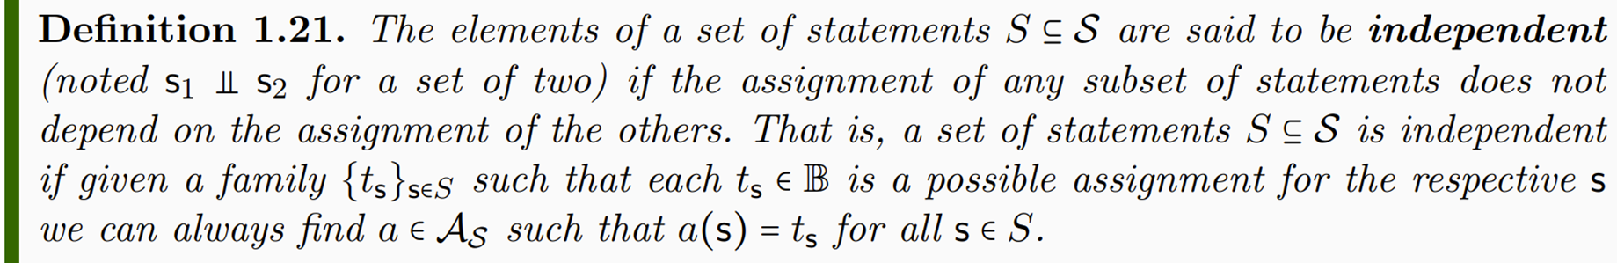

Slide 19


Slide 20




Slide 21


